Slide 1
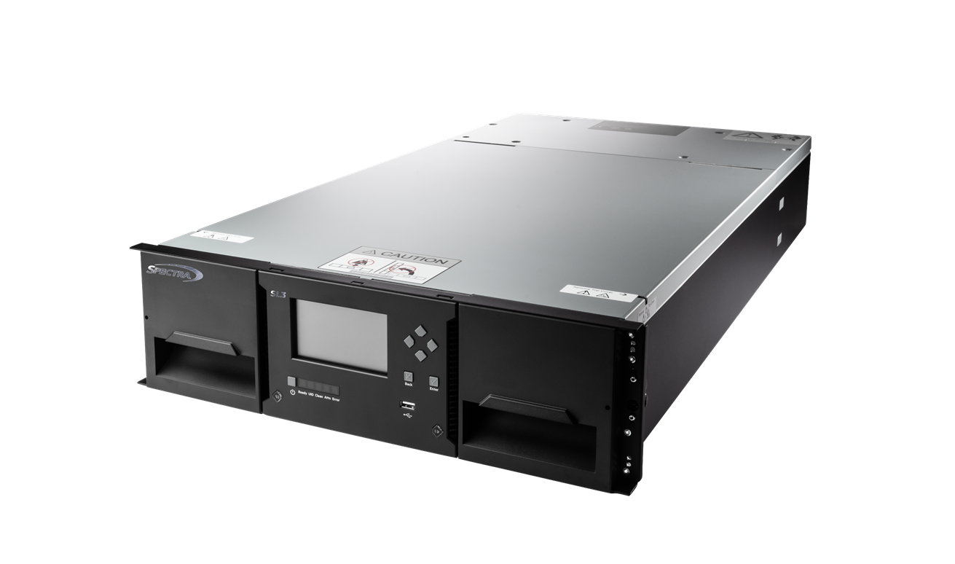
Spectra SL3 Tape Library
Simple, Scalable, and Secure
September 2025
Notes:
Today, we’re introducing the Spectra SL3 Tape Library.
It’s a 3U modular system built for simplicity, scalability, and security.
Ideal for small to mid-size organizations facing modern archive and data protection challenges.

Slide 2

5 Challenges of Archiving & Protecting Data
Expansive data retention growth
High online & cloud cold data storage costs
Long-term compliance pressure
Vulnerability to ransomware
Limited data center space
Notes:
Uncontrolled Data Growth: Organizations struggle to store and manage rapidly expanding volumes of unstructured data at the edge.
High Storage Costs: The cost of maintaining scalable disk or cloud storage environments is becoming unsustainable.
Long-Term Compliance Pressure: Many industries face strict regulatory demands to retain data securely for years or decades.
Vulnerability to Ransomware: Traditional online storage systems are exposed to cyberattacks, making backup data a frequent target.
Limited Data Center Space: IT teams are challenged to expand storage capacity without increasing their physical footprint.

Slide 3
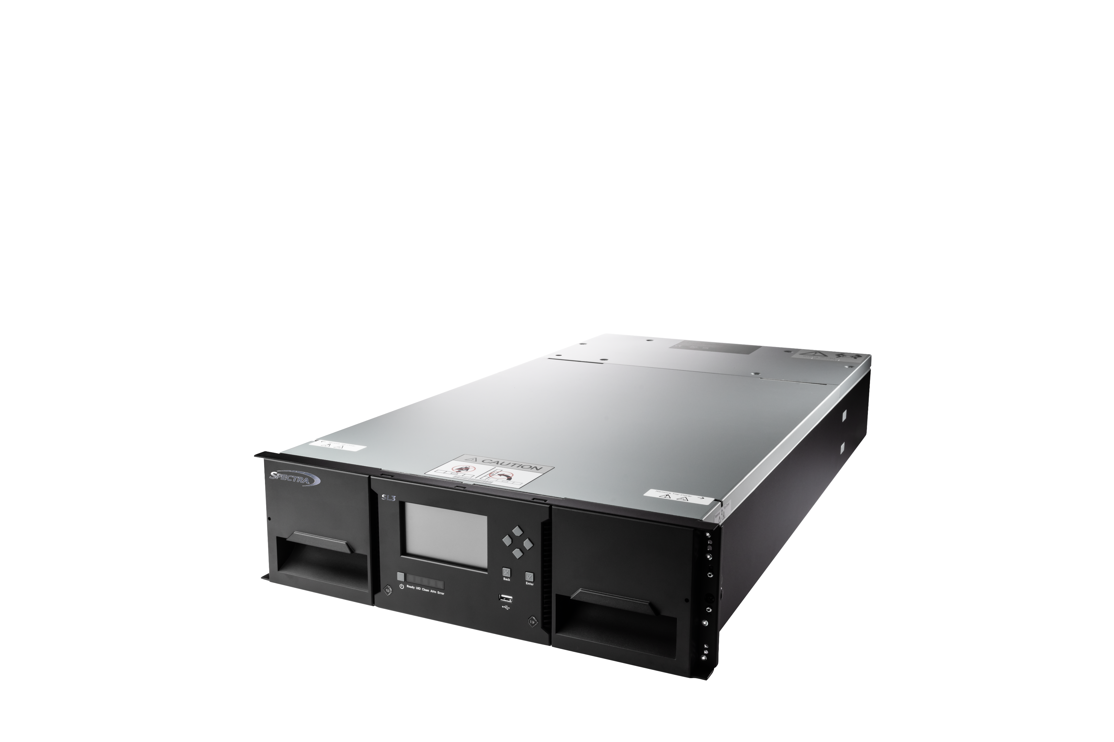
Simple, Scalable, and Secure Long-Term Data Retention
Spectra SL3 Tape Library
Simple to manage – Intuitive library software streamlines operations and reduces admin time
Scalable growth – Expand capacity and performance as data demands increase
Secure by design – Encryption, WORM media, and air gap options protect against cyber threats
Reliable long-term data storage – Preserve valuable data for decades with proven tape technology
Lowest cost of ownership – More economical than disk or cloud for safeguarding large
datasets long-term

Slide 4
Flexible Long-Term Data Retention Built for Growth
Start with a control module & expand as needed
3U base module
Up to fifteen 3U expansion modules
40 pre-licensed slots
3 HH, 1 FH, or 1 HH and 1 FH
drive per module
Scale to meet your needs
Up to 640 slots in a standard 48U rack
19.2 PB maximum capacity with LTO-10
1 to 48 LTO tape drives in a single library
FH and HH drives can be mixed in a single library
Easy to use
User serviceable
Manage, configure, and monitor from any remote location through a browser-based interface.
Automate everyday tasks through the ReST API
Notes:
3U base module and up to fifteen (15) 3U expansion modules
40 pre-licensed slots
3 HH, 1 FH, or 1 HH and 1 FH drive per module
Scalable
Up to 640 slots in a standard 48U rack
19.2 PB maximum capacity with LTO-10
1 to 48 LTO tape drives in a single library
FH and HH drives can be mixed in a single library
Easy to use
User serviceable
Manage, configure, and monitor from any remote location through a browser-based interface.
Automate everyday tasks through the ReST API

Slide 5
Spectra SL3 Library Benefits
Scalable high-density storage: Compact, modular design grows with demand
Investment protection: Supports multi-generational LTO technology
Usability & efficiency: Streamlined operations with intuitive management
Reliability: Proven platform ensures uptime and durability
Serviceability: Hot-swappable components minimize downtime
Notes:
Scalable High-Density Storage: Modular architecture allows organizations to scale capacity and performance as needed, delivering petabyte-level storage in a compact rack footprint.
Investment Protection: Supports earlier LTO generations and upcoming LTO releases.
Usability & Operational Efficiency: Simplifies daily operations with an intuitive web-based interface, automated media handling, and centralized management tools.
Reliability: Built on a proven hardware platform designed for consistent uptime and long-term durability.
Serviceability: Features hot-swappable drives and power supplies for minimal downtime.

Slide 6






Spectra SL3 Addresses Multiple Business Needs
Backup & Recovery
Scalable backup infrastructure for small to mid-size organizations.
Cold Storage & Archive
Cost-efficient solution for long-term retention of infrequently accessed data.
Ransomware Resilience
Creates secure, air-gapped storage for immutable backup copies.
Media & Entertainment
Efficient storage for massive video files, raw footage, and production assets.
Healthcare & Life Sciences
Archive medical imaging, genomics data, and electronic health records.
Surveillance & Compliance
Long-term storage of video surveillance or regulated data with retention requirements.
Notes:
Backup and Recovery: Scalable backup infrastructure for small to mid-size organizations.
Cold Storage and Archive: Cost-efficient solution for long-term retention of infrequently accessed data.
Ransomware Resilience: Creates secure, air-gapped storage for immutable backup copies.
Media and Entertainment: Efficient storage for massive video files, raw footage, and production assets.
Healthcare and Life Sciences: Archive medical imaging, genomics data, and electronic health records.
Surveillance and Compliance: Long-term storage of video surveillance or regulated data with retention requirements.

Slide 7

Spectra SL3 Features
Latest LTO support: LTO-6 through LTO-10
Expandable architecture: Scale from 3U to 48U
Flexible drive options: One full- or three half-height drives
Automated media handling: Robotic picker with barcode reader
Advanced management: Web-based GUI with remote monitoring
Data security: AES-256 encryption and WORM support
Partitioning & virtualization: Segmentation for multi-tenant storage
Notes:
Support for latest LTO generations: Including LTO-6, LTO-7, LTO-8, LTO-9, and LTO-10.
Expandable architecture: Modular growth from a 3U base unit up to 48U multi-module configurations.
Up to 1 full-height or 3 half-height drives per module: Offers flexibility for throughput and capacity.
Automated media handling: Robotic picker with barcode reader for accurate and efficient media management.
Advanced management interface: Web-based GUI, remote monitoring, and diagnostics tools.
Encryption and WORM support: Hardware-based AES-256 encryption and Write Once Read Many (WORM) capabilities.
Partitioning and virtualization: Enables segmentation for multi-tenancy or department-level storage pools.

Slide 8
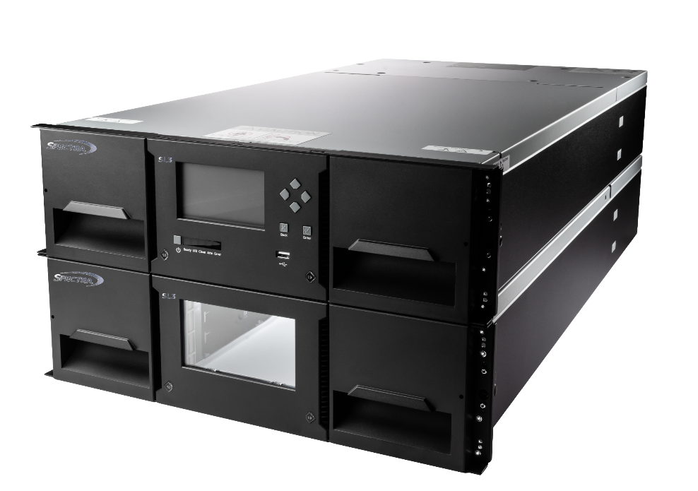
Achieve Scalable Growth
Modular expansion: Start small and scale by adding additional 3U expansion modules.
Flexible slot growth: Accommodate up to 1.2PB of native storage per module (LTO-10).
  All modules have fully licensed slots
  Up to 15 expansion modules
  Maximum 640 slots for 19.2 PB native capacity
Drive scalability: Increase performance as workloads grow.
  Supports 3 half-height or 1 full-height LTO drive per module
  Expand up to 16 full- or 48 half-height LTO tape drives
  Mix FH and HH drives may be mixed in a library
Pay-as-you-grow model: Add performance and capacity incrementally to optimize investment over time.
Flexible configuration: Easily adapt to changing data retention needs without disrupting existing operations.
Spectra SL3 Library with 3U Expansion Module
Notes:
Modular Expansion: Start with a single 3U base unit and scale by adding additional 3U expansion modules—no need to replace hardware.
Slot Growth: Expand from 40 to over 640 LTO cartridge slots, accommodating up to 1.2PB of native storage per module (LTO-10).
All modules have fully licensed slots
Up to 15 expansion modules
Maximum 640 slots for 19.2 PB native capacity
Drive Scalability: increasing performance as workloads grow.
Supports up to 3 half-height or 1 full-height LTO drives per module,
Expand up to 16 full- or 48 half-height LTO tape drives
Mix FH and HH drives may be mixed in a library
Pay-As-You-Grow Model: Add capacity and performance incrementally, optimizing investment over time.
Flexible Configuration: Easily adapt to changing data retention needs without disrupting existing operations.

Slide 9
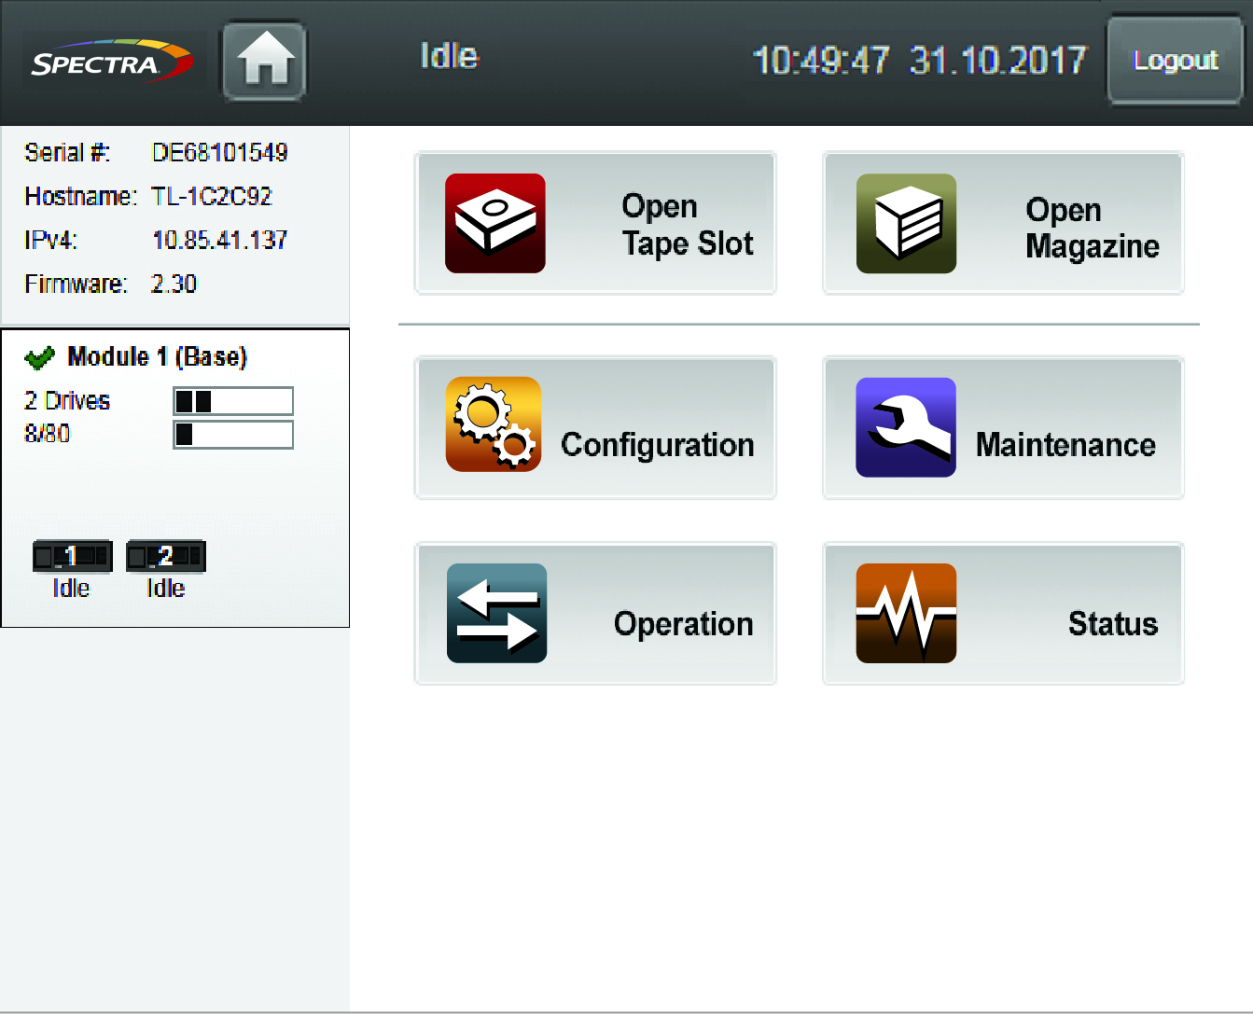
Easy to Deploy & Manage
Simple installation
Installs in under 1 hour for fast deployment.
Remote management interface
Browser interface enables simple, remote system control.
Automated robotics
Handles media loading and inventory automatically—no manual intervention required.
Barcode reader
Ensures fast, accurate media inventory to minimize administrative time and reduce human error.
Leverages existing infrastructure
Fibre Channel and SAS support simplify connections and lower costs.
Spectra SL3 Library Management Software UI
Notes:
Simple Installation: Rack-mount design allows for quick and straightforward deployment in under 1 hour.
Remote Management Interface: Built-in browser-based management simplifies system configuration, monitoring, and troubleshooting.
Automated Robotics: Integrated robotic picker handles media loading and inventory automatically—no manual intervention required.
Barcode Reader: Accelerates tape recognition and slot inventory, minimizing administrative time and reducing human error.
Leverages Existing Infrastructure: Easily connects to your environment using Fibre Channel or SAS, reducing deployment time, cost, and complexity.

Slide 10
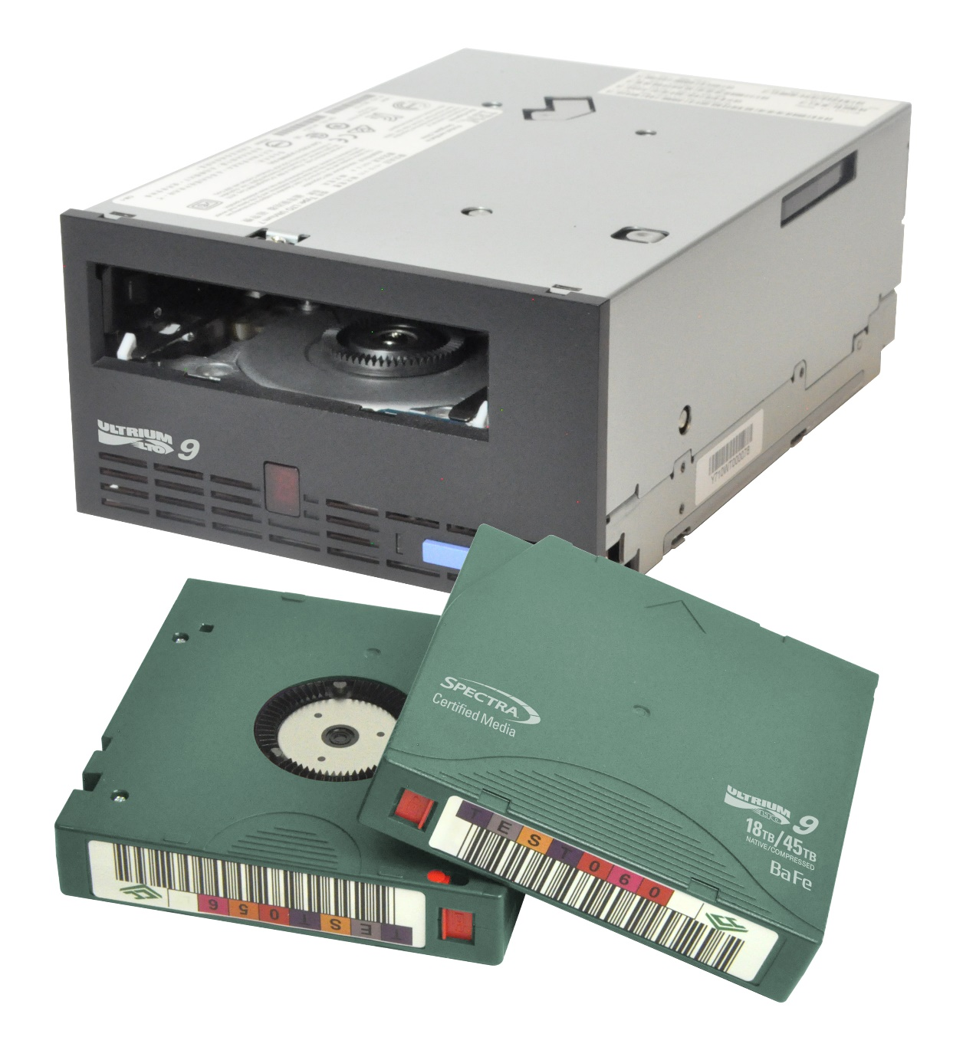
Easy to Maintain
Efficient tape media handling
Expedite tape media installation and management with two magazines per module
Non-disruptive media import/export
Add or remove tape media while keeping the library online
Modular components
Replace drives or power supplies in under 5 minutes, minimizing downtime and complexity.
Self-service with replaceable components
Designed for administrative staff with comprehensive service guides
Notes:
Efficient tape media handling
Expedite tape media installation and management with two magazines per module
Non-disruptive media import/export
Add or remove tape media while keeping the library online
Modular Components:
Replace drives or power supplies in under 5 minutes, minimizing downtime and complexity.
Self-service with replaceable components
Designed for administrative staff with comprehensive service guides

Slide 11





Proven Reliability
Consistent Performance
  Designed for 24/7 operations
  Precision robotic picker ensures consistent, error-free media handling
Redundant Architecture
  Optional path failover for data and control
  Optional dual power supplies enhance system uptime and fault tolerance
Built-in Monitoring Tools
  Real-time system health checks and predictive diagnostics help prevent unexpected downtime
Highest Media Quality Standards
  Every cartridge is cleaned, tested, and verified before use
  Lifetime Guarantee for Spectra Certified Media
Notes:
Consistent Performance
Designed for 24/7 operations
Precision robotic picker ensures consistent, error-free media handling
Redundant Architecture
Optional path failover for data and control
Optional dual power supplies enhance system uptime and fault tolerance
Built-in Monitoring Tools
Real-time system health checks and predictive diagnostics help prevent unexpected downtime
Spectra Certified Media for Highest Quality Standards
Every cartridge is cleaned, tested, and verified before use
Lifetime Guarantee for Spectra Certified Media

Slide 12

Spectra Certified Media
Proprietary Cleaning Process
Debris-free media prolongs tape drive lifespan, enhancing performance and capacity
Proven Reliability
Ensure superior performance and reliability with rigorous testing and quality control
Dependable Performance
Reduce write errors and improve tape drive efficiency for faster, more dependable performance
Bar Code
Tagging
Pre-applied custom or standard barcodes ensure continuous tracking efficiency
Lifetime
Guarantee
Protect your investment with a no-questions-asked replacement policy for any defective tape or cleaning cartridge*
* Spectra Certified Media coverage does not extend to tape media or cleaning media that have naturally worn out due to deterioration resulting from routine operations, standard wear and tear, or reaching the end of their functional life. Customers should follow recommended usage guidelines and replacement schedules to maintain optimal performance.

Slide 13
Spectra SL3 Technical Specifications
Library | Control Module | Fully Configured with 15 Expansion Modules
Max. Media/Slot Count | 40 | 640
Max. Native Capacity¹ | 1.2 PB | 19.2 PB
Max. Compressed Capacity² | 3.0 PB | 48.0 PB
Form Factor | 3U | 48U
Max. Drives | 1 Full Height, 3 Half Height, or 1 Full Height and 1 Half Height | 16 Full Height or 48 Half Height, or drive mixture range 46 HH/1 FH to 16 HH /16 FH
Max. Native Throughput (TB/hr.)¹ | 3.2 (HH) 1.4 (FH) | 51.8 (HH) 23.0 (FH)
Max. Partitions | 20 | 20
Tape Drives Supported³ | LTO-6, LTO-7, LTO-8, LTO-9, and LTO-10 Available with SAS and/or Fibre Channel Interfaces
Power Supplies | 1 standard power supply, optional 2nd redundant supply | NA
Dimensions H x W x D Millimeters (Inches) | 134 x 475 x 892 (5.27 x 18.7 x 35.1) | 2,144 x 475 x 892 (84.32 x 18.7 x 35.1)
Capacities and throughputs are based on LT0-10 tape technology. HH Throughput is based on LTO-9
LTO compressed capacity is 2.5 to 1.
Half-height (HH) drives support Fibre Channel and SAS. Full-height (FH) LTO tape drives support Fibre Channel (also SAS for LTO-9 and LTO-10).

Slide 14

Why Spectra SL3 Library?
Modular, scalable design: scale capacity and performance without disruption.
Enterprise-level density: Delivers up to 1.2 PB (native) in just 3U of rack space, optimizing storage footprint.
LTO technology support: Compatible with LTO-6 through LTO-10 drives and media.*
Secure and efficient: Offers AES-256 encryption, WORM support, and air-gapped protection against ransomware threats.
User-friendly management: Intuitive interface, remote monitoring, and automated robotics for simplified operation.
*Refer to Spectra SL3 library specifications.
Notes:
Modular, scalable design: scale capacity and performance without disruption.
Enterprise-level density: Delivers up to 1.2 PB (native) in just 3U of rack space, optimizing storage footprint.
LTO technology: Supports LTO-6 through LTO-10 drives and media, can intermix within the library.
Secure and efficient: Offers AES-256 encryption, WORM support, and air-gapped protection against ransomware threats.
User-friendly management: Intuitive interface, remote monitoring, and automated robotics for simplified operation.

Slide 15
Thank You
www.spectralogic.com
Notes:
Thank you for your time today.
For more information, visit www.spectralogic.com or reach out to our team.
We’re happy to help with sizing, demos, or technical details.

